Slide 1
Team A.S.K.
Project Overview
Michael Ashe Lead HTML, UI Developer
Luke Stroud Lead JS, jQuery Developer
David Killian Lead AJAX, Firebase Developer

Slide 2
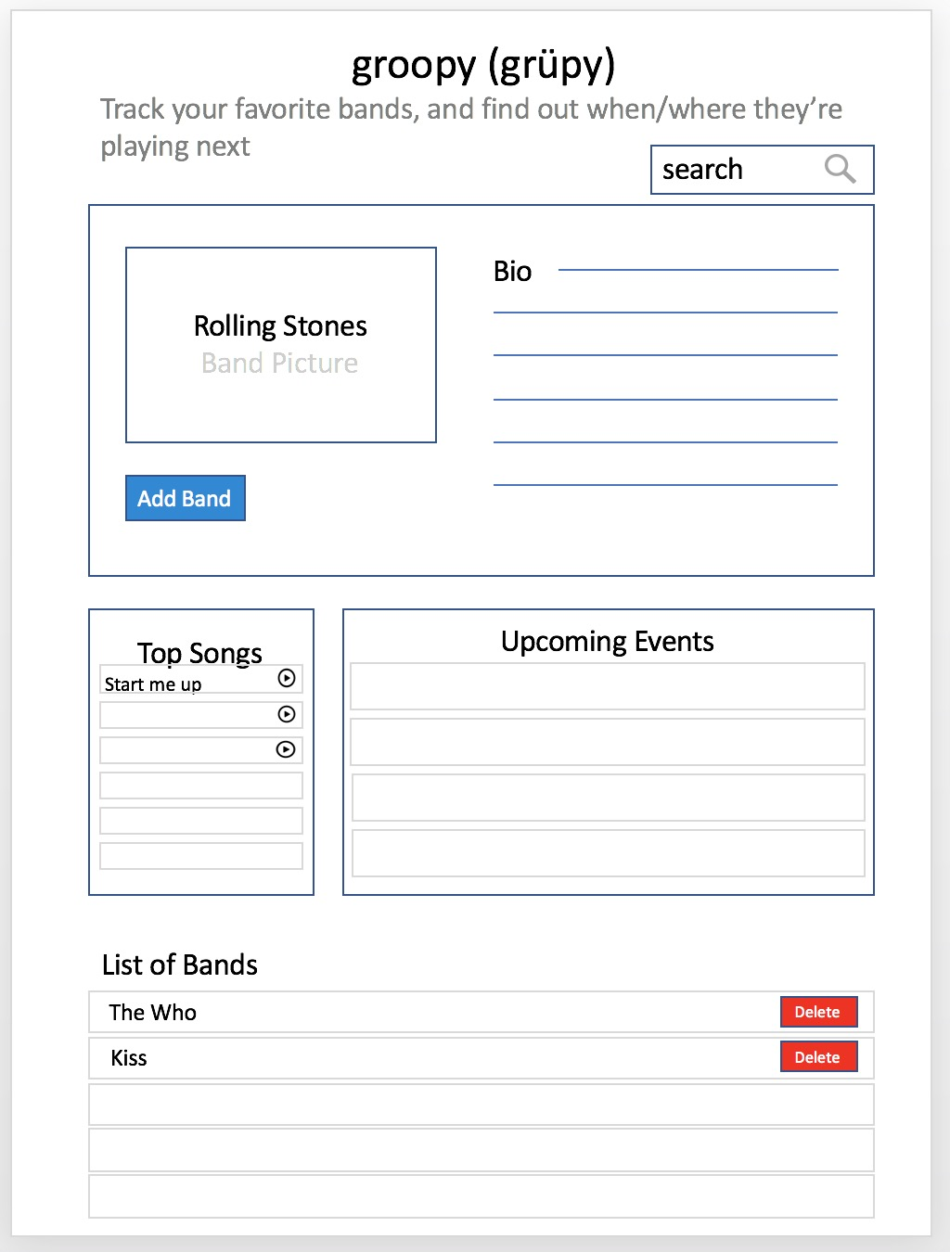
Our Vision – Day 1
Welcome to groopy
Dictionary
groupie | ‘grü-pē | noun informal
A person who regularly follows a pop music or other celebrity in the hope of meeting or getting to know them.
A handy app to track our favorite bands and where they are playing next
Pull pertinent data for band bio, image, top songs, upcoming events
Design a clean, easy-to-use interface…
…and a cool name!

Slide 3
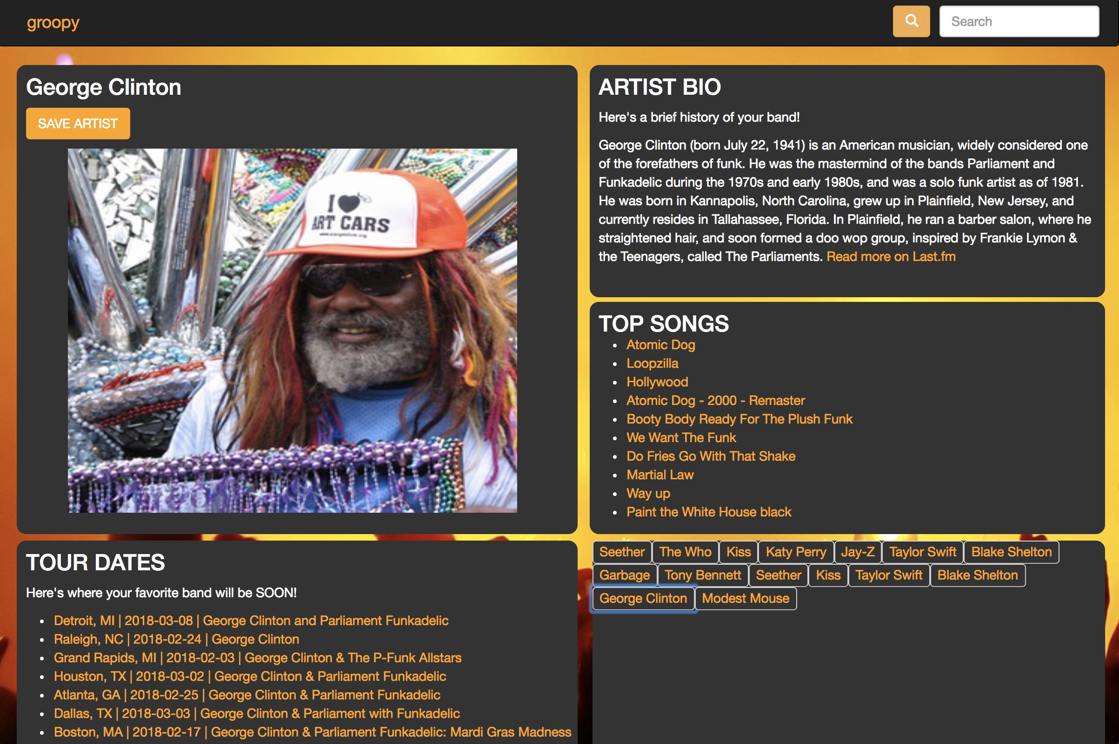
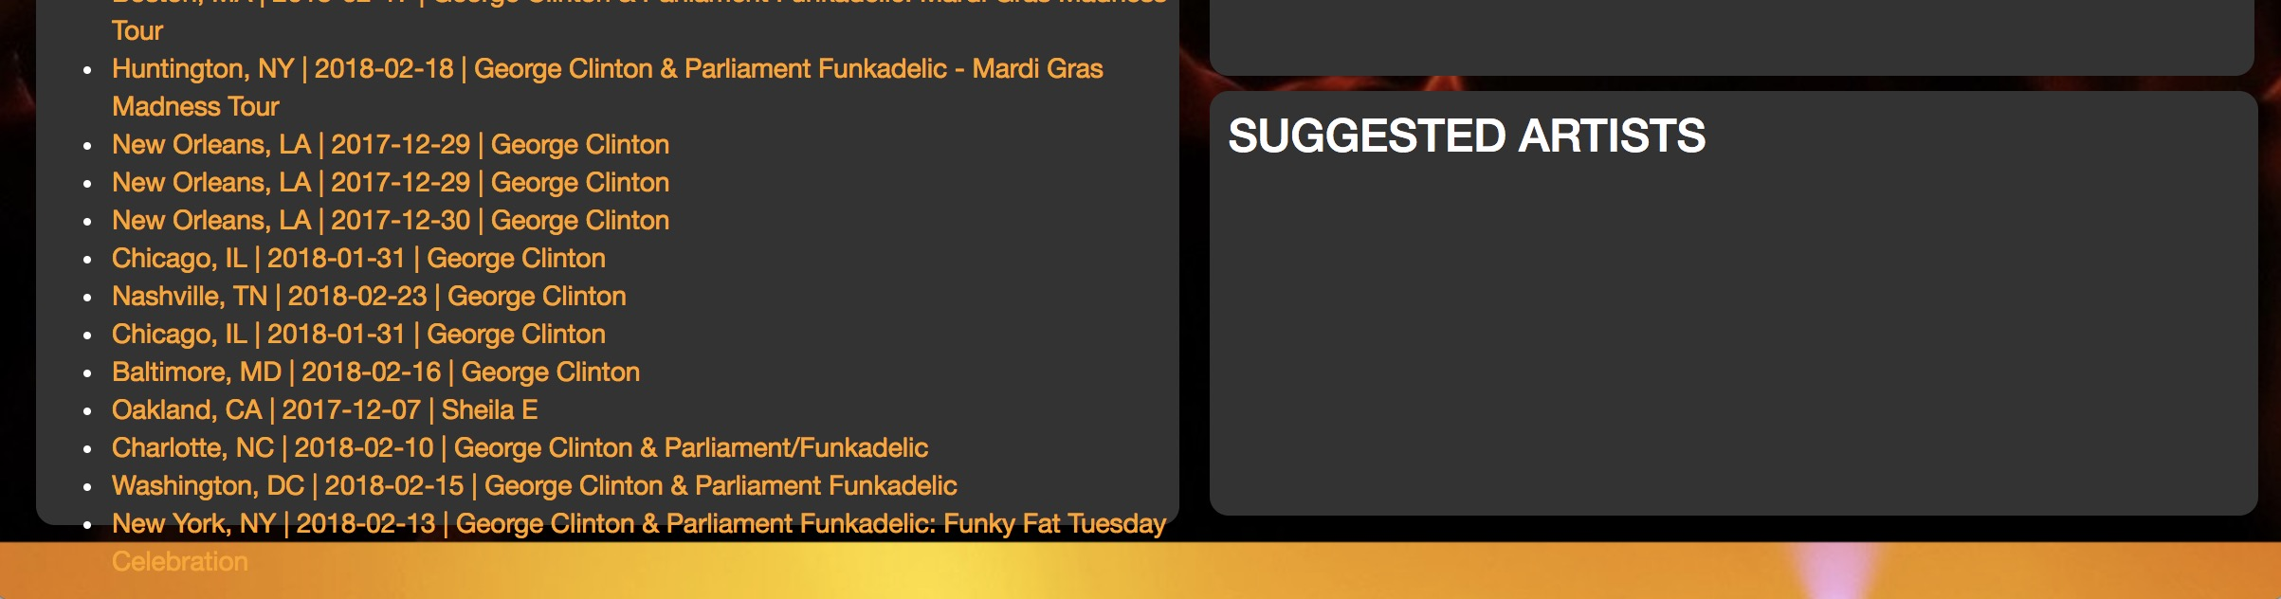
Our Implementation
Met MVP Goals
Data from last.fm, Ticketmaster
Firebase for persistence
“Favorite Bands” quick reference
Modified Bootstrap via CSS
groopy.com domain still exists!

Slide 4
Our Challenges
git
…Slack is good for lots of things
Exception handling
Data fidelity (affiliates, ‘events’)
Fighting Bootstrap

Slide 5
Our Roadmap
Store bands locally on client
Improve error handling & formatting
Improve mobile responsiveness
Add: delete button, suggested bands, recent tweets, embedded media player, proximity (Google Maps)
Add metric representing popularity & play count for songs
Create message board for events

Slide 6
Lesson’s Learned
Over communicated
Had daily goals
Asked for help (Thanks Monique, Zach, Josh and Jack!!!!)
Weren’t afraid to break the code!
Groundwork for a viable app!
Kiss is great…LOL :P

Slide 7
Demo Time!!!

